Slide 1


DEPT. OF COMPUTER SCIENCE & ENGINEERING
CMR TECHNICAL CAMPUS
UGC AUTONOMOUS
Accredited by NBA & NAAC with ‘A’ Grade
Approved by AICTE, New Delhi and JNTU, Hyderabad
ESTD : 2009
ESTD: 2009
MEMBERSHIP INFERENCE ATTACK AND DEFENCE FOR WIRELESS SIGNAL CLASSIFIERS WITH DEEP LEARNING
Under the guidance
Dr. V Naresh Kumar
Project Coordinator
Dr. J Narasimha Rao
Group Members
N. Vaishnavi(217R1A05P4)
B. Meenakshi(217R1A05L5)
G. Jaswanth Kumar(217R1A05M9)

Slide 2
CONTENTS:
Abstract
Existing System
Disadvantages
Proposed System
Advantages
Hardware & Software Requirements
Novelty Of The Project
Architecture
Modules
UML Diagrams
Sample code
Results
Conclusion
Future Scope
References
Github link

Slide 3
ABSTRACT:
An over-the-air membership inference attack (MIA) is presented to leak private information from a wireless signal classifier.
Machine learning (ML) is used to classify wireless signals, which helps authenticate devices and prevent unauthorized access.
MIA is an attack where an adversary tries to determine if specific data (like a signal) was used to train a target ML model.
If the adversary figures out which signals were in the training data, they could learn sensitive details about signals, like the specific device or channel characteristics. This information could reveal security weaknesses.
In wireless networks, signals received by the adversary differ from those received by the intended model due to changes in channel conditions (like interference). This makes the attack more challenging.
To overcome this, the adversary builds a "surrogate" classifier by observing wireless signals in the environment. This surrogate model mimics the target model's behavior.

Slide 4
EXISTING SYSTEM:
An existing system presents channel-aware adversarial attacks against deep learning-based wireless signal classifiers.
A system transmits signals with different modulations, and each receiver uses a neural network to classify the signal types.
When channels are not considered in designing these attacks, they fail; but realistic attacks that factor in channel effects succeed in fooling the target receiver.
A selective attack targets only specific receivers by considering their channel effects, while a broadcast attack uses general interference to fool multiple receivers.
Modulation classifiers are shown to be vulnerable when different levels of information about the channel, transmitter input, or classifier model are available to the adversary.
A deep neural network is used at each receiver to classify its over-the-air received signals to modulation types.

Slide 5
DISADVANTAGES:
Privacy Breach
Security Vulnerability
Dependence on Information Availability
Complex Implementation
Adversarial Adaptation
Limited Effectiveness in Complex Channels

Slide 6
PROPOSED SYSTEM:
Introduction of MIA on Wireless Classifiers: This project presents the first over-the-air Membership Inference Attack (MIA) against a wireless classifier to infer training data and expose private information on waveforms, devices, and channels.
MIA Scenarios: We examine two cases:
(i) MIA identifies signals from the same device as member or non-member,
(ii) non-member signals come from different devices.
Extended MIA with Channel Variations: The MIA also uses received signals with added noise to account for channel variations.
High Attack Success: Numerical results show MIA achieves high accuracy in identifying training data membership in the wireless classifier.
Defense Strategy: A defense method is proposed, significantly reducing the MIA's accuracy.

Slide 7
ADVANTAGES:
Identify vulnerabilities
Compliance with privacy standards
Data privacy protection
Prevent unauthorized data extraction
Adaptability to evolving threats

Slide 8
HARDWARE REQUIREMENTS:
Processor : Pentium IV or higher
RAM : 8 GB or above
Space on Hard Disk : 256 GB
SOFTWARE REQUIREMENTS:
Operating System : Windows 7 or above
Programming Language : Python 3.6.2 version
Frontend Technologies : HTML, CSS, JavaScript

Slide 9
NOVELTY:
Focus on Wireless Signal Data: Membership inference attacks are specifically applying to wireless signal data. Wireless data has unique characteristics, like noise sensitivity and temporal dependencies, which might impact the effectiveness of inference attacks and defenses differently than other domains.
Develop Domain-Specific Defenses: Most existing defenses are developed for general-purpose applications. You could innovate by designing signal-specific defenses optimized for wireless classifiers, perhaps leveraging unique characteristics of wireless signals.
Signal-based Differential Privacy: Design a differential privacy mechanism adapted for the unique properties of wireless signals.
Adaptive Noise Injection: Develop a novel adaptive noise injection method tailored specifically for wireless signal data. This would involve adding targeted noise to the classifier’s outputs or inputs in a way that disrupts an attacker's ability to confidently infer membership, without significantly affecting classification performance.

Slide 10
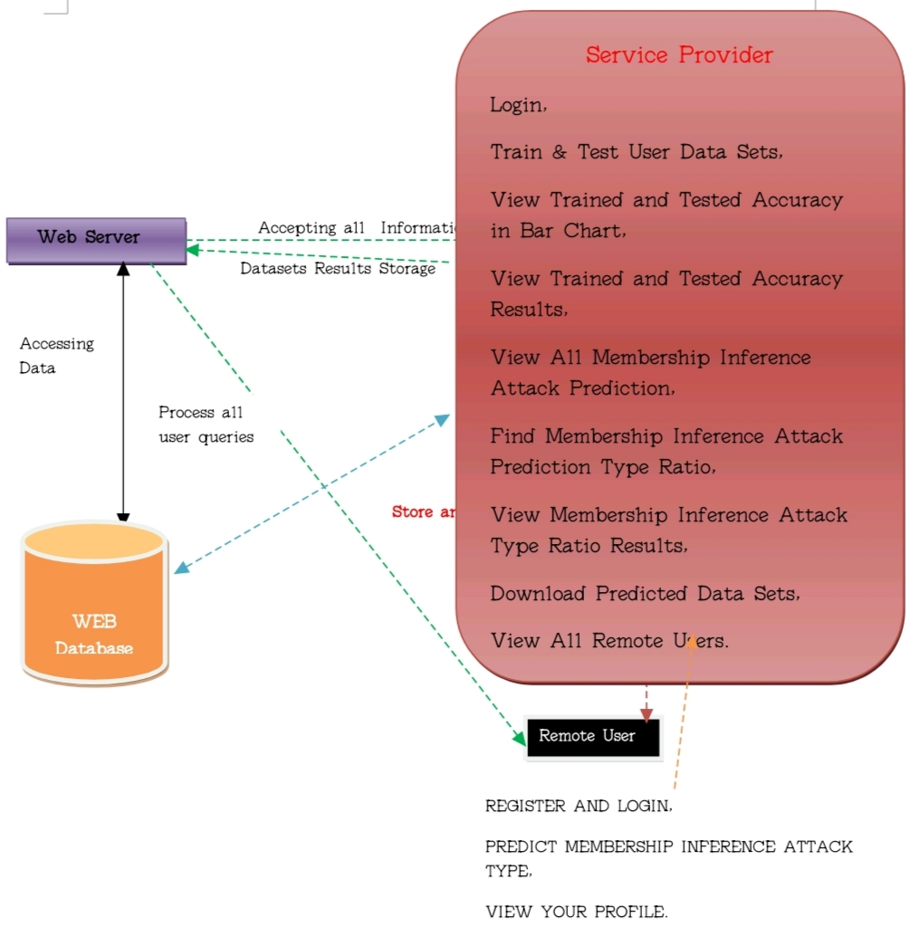
ARCHITECTURE:

Slide 11
MODULES:
Service Provider
Remote User

Slide 12
UML DIAGRAMS

Slide 13
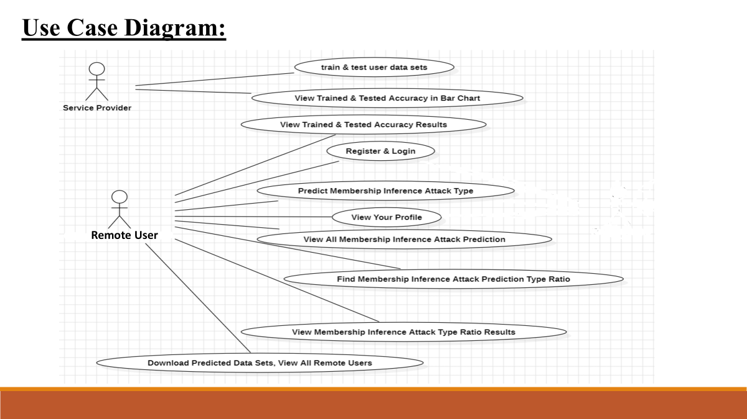

Slide 14
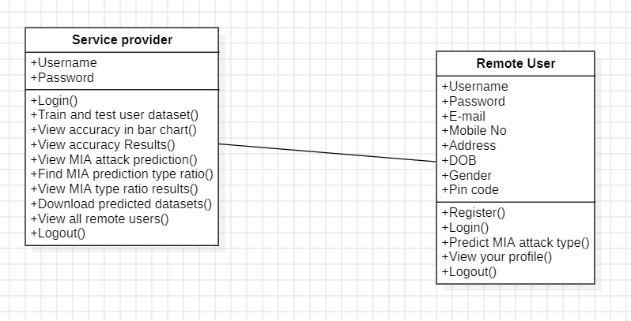
Class Diagram:

Slide 15
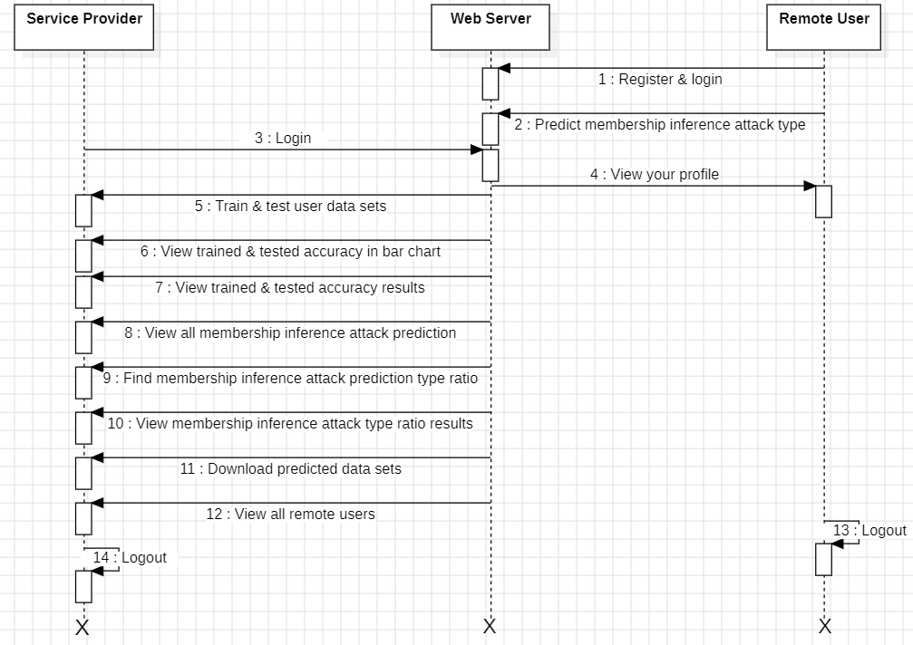
Sequence Diagram:

Slide 16
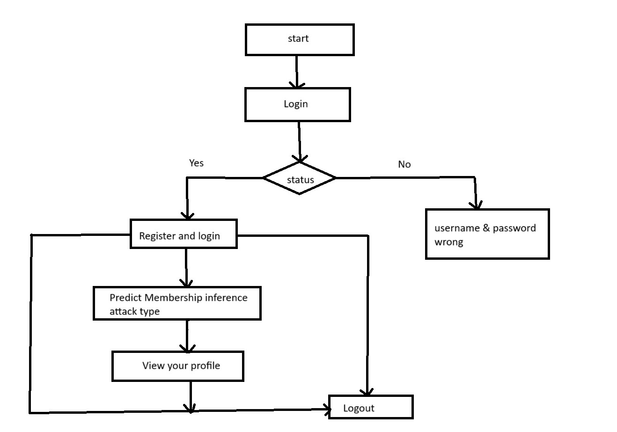
Activity Diagram

Slide 17
Sample code
from django.db.models import Count, Avg
from django.shortcuts import render, redirect
import xlwt
from django.http import HttpResponse
import numpy as np from sklearn.feature_extraction.text import CountVectorizer
from sklearn.metrics import accuracy_score, confusion_matrix, classification_report
from sklearn.metrics import accuracy_score
import pandas as pd
from Remote_User.models import ClientRegister_Model,inference_attack_detection,detection_ratio,detection_accuracy def serviceproviderlogin(request):
if request.method == "POST":
admin = request.POST.get('username')
password = request.POST.get('password')
if admin == "Admin" and password =="Admin":
return redirect('View_Remote_Users’)
return render(request,'SProvider/serviceproviderlogin.html')

Slide 18
def View_Membership_Inference_Attack_Prediction(request):
obj = inference_attack_detection.objects.all()
return render(request, 'SProvider/View_Membership_Inference_Attack_Prediction.html', {'objs': obj})
def View_Membership_Inference_Attack_Prediction_Ratio(request):
detection_ratio.objects.all().delete()
ratio = ""
kword = 'No Attack'
print(kword)
obj = inference_attack_detection.objects.all().filter(Prediction=kword)
obj1 = inference_attack_detection.objects.all()
count = obj.count();
count1 = obj1.count();
ratio = (count / count1) * 100
if ratio != 0:
detection_ratio.objects.create(names=kword, ratio=ratio)
ratio1 = ""
kword1 = 'Poisoning or Causative Attack'
print(kword1)

Slide 19
obj1 = inference_attack_detection.objects.all().filter(Prediction=kword1)
obj11 = inference_attack_detection.objects.all()
count1 = obj1.count();
count11 = obj11.count();
ratio1 = (count1 / count11) * 100
if ratio1 != 0:
detection_ratio.objects.create(names=kword1, ratio=ratio1)
ratio12 = ""
kword12 = 'Trojan Attack'
print(kword12)
obj12 = inference_attack_detection.objects.all().filter(Prediction=kword12)
obj112 = inference_attack_detection.objects.all()
count12 = obj12.count();
count112 = obj112.count();
ratio12 = (count12 / count112) * 100

Slide 20
RESULTS

Slide 21
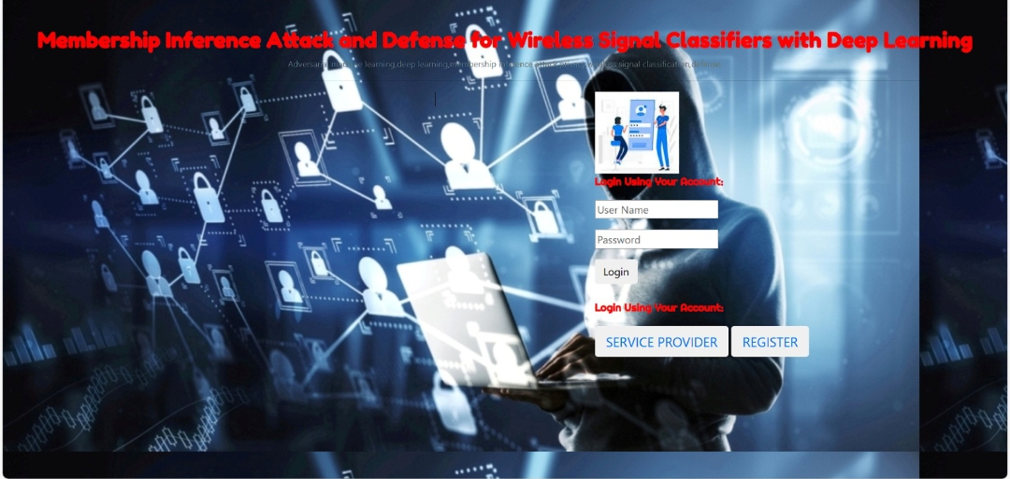

Slide 22
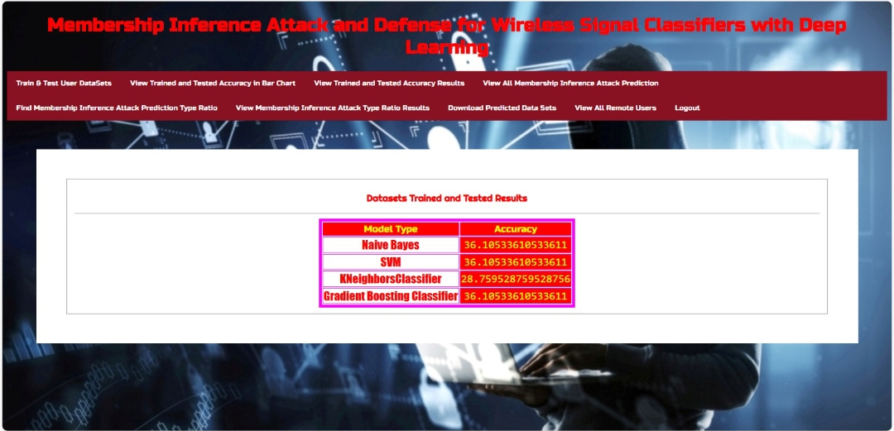

Slide 23


Slide 25
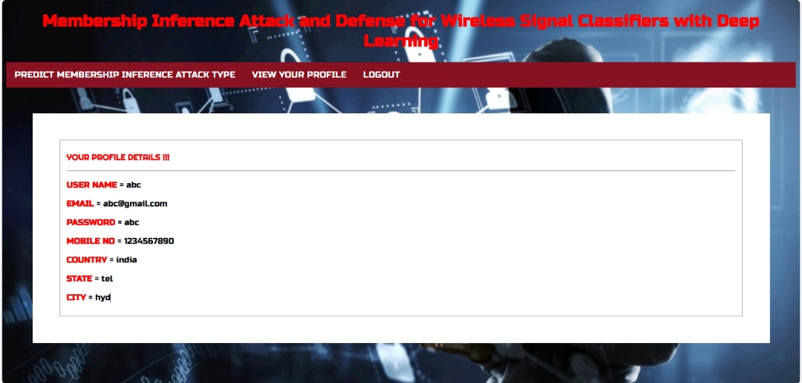

Slide 26
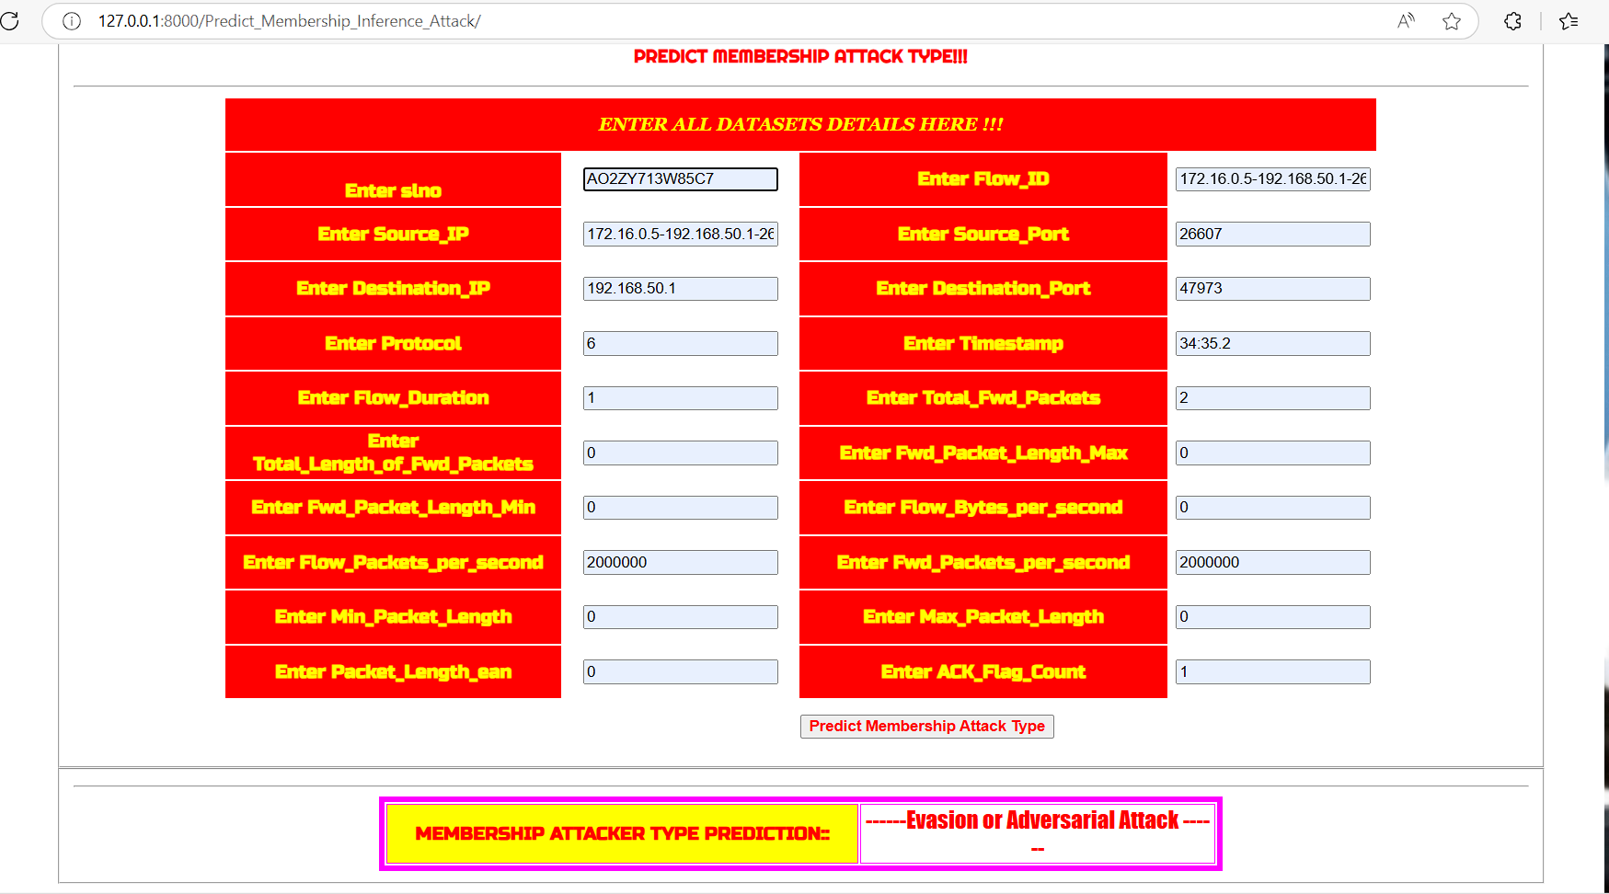

Slide 27
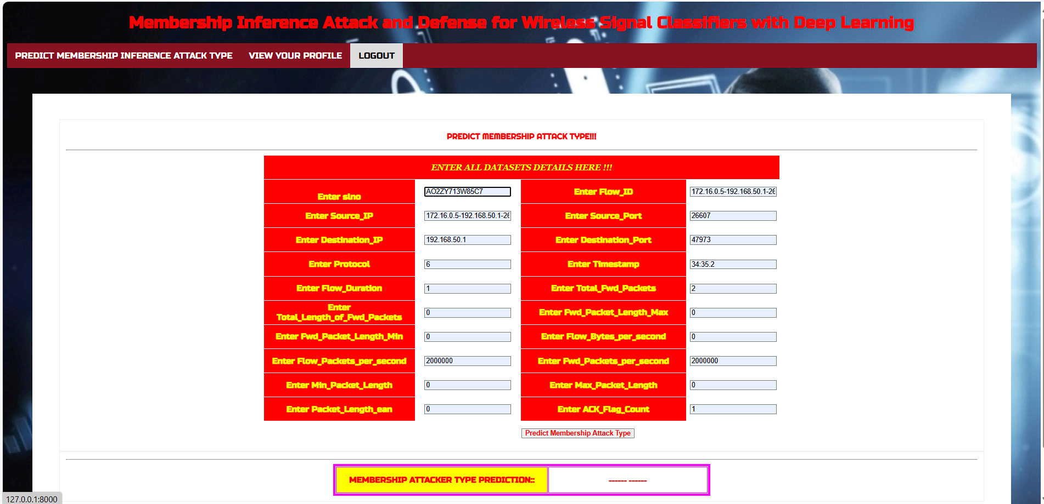

Slide 28
CONCLUSION:
This project presents a Membership Inference Attack (MIA) on deep learning-based wireless signal classifiers, revealing a significant privacy vulnerability in wireless communication systems. The study demonstrates that an adversary can infer whether specific signals were used in the training data of a classifier, leading to potential leaks of waveform, device, and channel characteristics.
The results indicate that MIA can achieve high accuracy (up to 97.88%), proving that wireless classifiers unintentionally expose private information. The attack is further improved by accounting for channel variations and noisy signal conditions, making it realistic and effective in real-world wireless environments.

Slide 29
FUTURE SCOPE:
Stronger Privacy-Preserving Techniques
Advanced Defensive Mechanisms
Expanding Attack Scenarios
Real-World Implementation and Testing

Slide 30
REFERENCES
[1] Y. Shi, K. Davaslioglu, and Y. E. Sagduyu, “Over-the-Air Membership Inference Attacks as Privacy Threats for Deep Learning-based Wireless Signal Classifiers,” ACM Conference on Security and Privacy in Wireless and Mobile Networks (WiSec) Workshop on Wireless Security and Machine Learning (WiseML), 2020.
[2] T. Erpek, T. O’Shea, Y. E. Sagduyu, Y. Shi, and T. C. Clancy, “Deep Learning for Wireless Communications” in Development and Analysis of Deep Learning Architectures, Springer, 2020.
[3] Y. E. Sagduyu, Y. Shi, T. Erpek, W. Headley, B.Flowers, G. Stantchev, and Z. Lu, “When Wireless Security Meets Machine Learn ing: Motivation, Challenges, and Research Directions,” arXiv preprint arXiv:2001.08883, 2020.
[4] D. Adesina D, C. C. Hsieh, Y. E. Sagduyu, and L. Qian, “Adversarial Machine Learning in Wireless Communications using RF Data: A Review,” arXiv preprint arXiv:2012.14392, 2020.
GITHUB LINK

Slide 31
THANK YOU

